Slide 1
Final Project Review
Team QuickTab
April 24th, 2017
Notes:
‹#›
‹#›
‹#›
‹#›

Slide 2
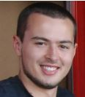
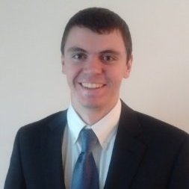
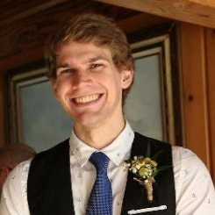
QuickTab (Intuitive Tablature Generation)
Joe Biegaj
EE
Lindsay Manning
EE
John Bonk
EE
Jacob Prescott
EE
Notes:
‹#›
‹#›
‹#›
‹#›

Slide 3
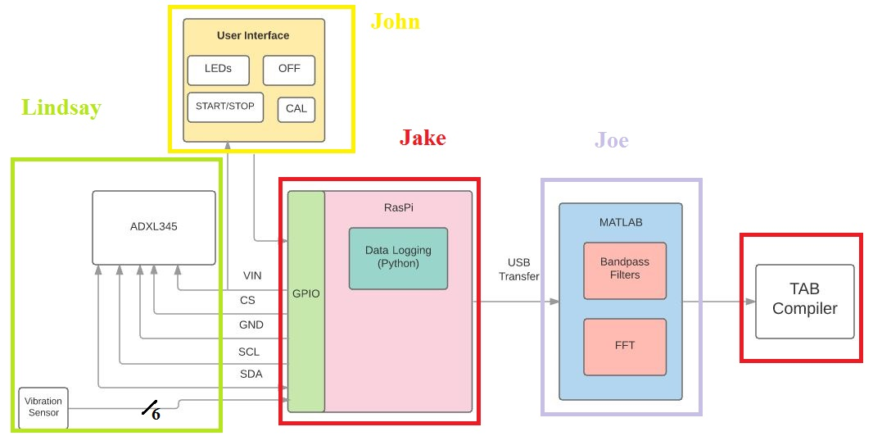
Block Diagram
Notes:
‹#›
‹#›
‹#›
‹#›
Lemon costs $1 (Good point)

Slide 4
FPR Deliverables
Completely integrated and packaged system capable of tablature recovery with at least 90% accuracy over a signal containing 25 notes.
John
Remove the need for a visual display on the Raspberry Pi
Integrate PCB
Global ‘OFF’ button
Jake
Implement visualization of TAB Compiler
Enable user-friendly data transmission between Raspberry Pi and Computer
Joe
Improve FFT logic in order to achieve 90% fret detection accuracy
Implement calibration into MATLAB code
Lindsay
Optimize vibration sensor thresholds to improve FFT analysis
3D printed casing for the sensor strip and PCB

Slide 5
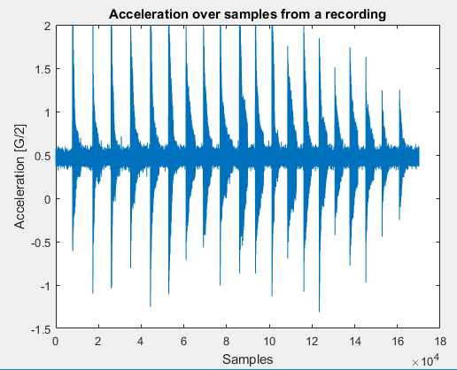
Data Logging with Raspberry Pi
Increased sampling frequency from the 1600Hz at CDR to a consistently working 3200Hz.
Our successful solution was to change the baud rate of the I2C from the Raspberry Pi default of 800kHz to 1MHz
3200Hz allows us to get both vibration data and all of the notes on the guitar
Removed signal squaring and limited sensing to one axis
Implemented wireless transfer of data from the Pi to an e-mail address through wi-fi
Notes:
‹#›
‹#›
‹#›
‹#›

Slide 6
Vibration Sensors
Sensor selection is finalized and implemented
on all six strings.
The output of the six piezo vibration sensors are fed into a 10-bit-to-Analog ADC that utilizes SPI.
The python script creates a file that lists which sensor was triggered and when it was triggered. This process is initialized by hitting the ‘record’ button on the UI.
Housing for the sensor strip has been
completed and implemented

Slide 7
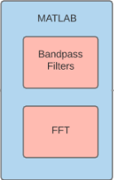
MATLAB
Fret and String detection
Raw ADXL and vibration sensor data is read in from the Raspberry Pi
We iterate through the sensor data to find out what strings were played
For each vibration detected a filter is applied that corresponds to the string played
The timestamp from the vibration sensors is used to determine where to take the FFT’s
Calibration
Accurate fret detection requires knowledge of base frequency of each string. We have incorporated a calibration function to accommodate any tuning.
When initialized the code stores the values of the open string
frequencies as the standard tuning values (E, A, D, G, B, e)
The calibrate button on the PCB will send a calibrate file that can be
read into the code
This data is processed the same way as above and the new values are
stored in the string frequency array until a new calibration file is read in

Slide 8
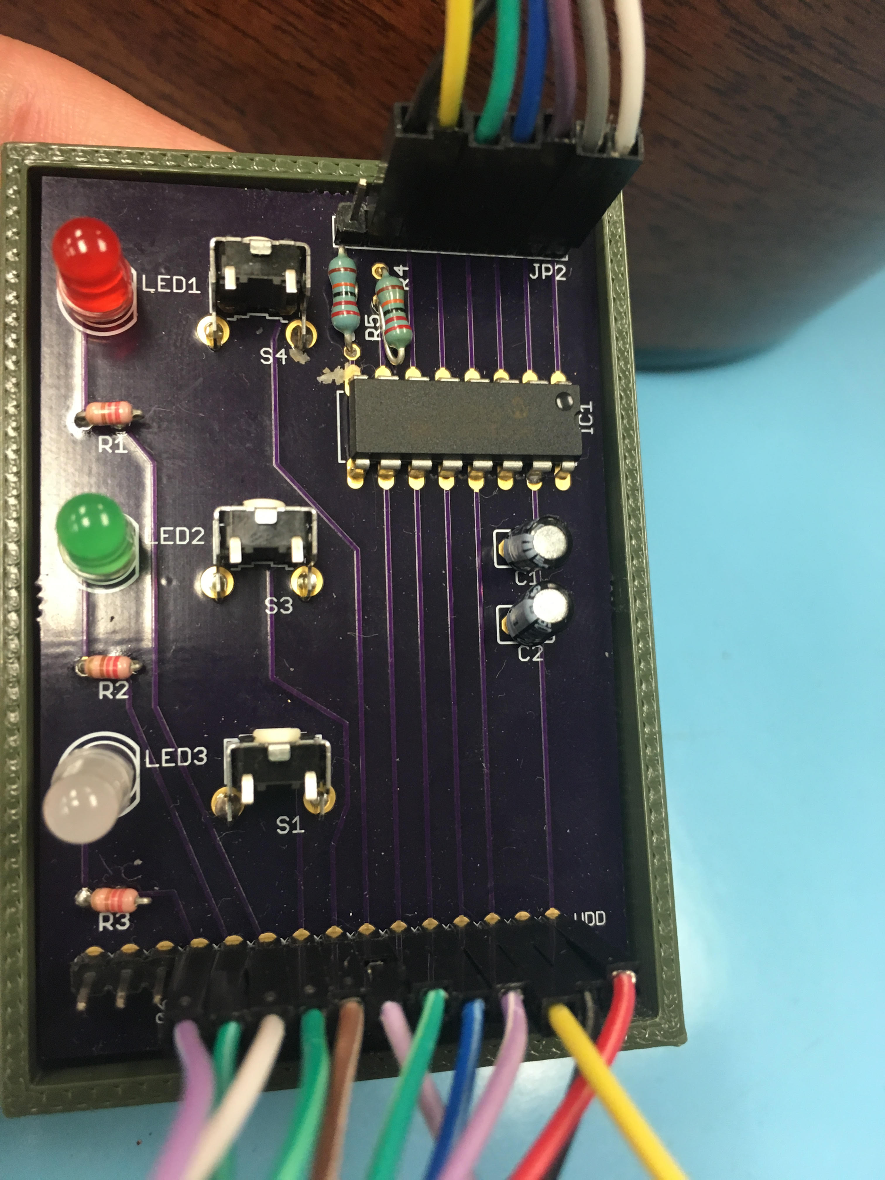
User Interface & PCB
LED Meanings:
Red: Currently Recording
Green: Ready to record/calibrate
White: Currently Calibrating
Shutdown button has been implemented
Button Functions:
Record button is placed next to the red
LED
Shutdown button is next to the green
LED
Calibrate button is next to the white
LED
The need for a monitor has been eliminated
while still allowing us to have full
functionality of recording, shutdown, and calibration

Slide 9
Creating Tablature (TAB Compiler)
By using the timestamps and string signature from the vibration sensors in coordination with our FFTs from our sampling we are able to output a visual representation of tablature
Example:
Notes:
‹#›
‹#›
‹#›
‹#›

Slide 10
FPR Deliverables
Completely integrated and packaged system capable of tablature recovery with at least 90% accuracy over a signal containing 25 notes.
John
Remove the need for a visual display on the Raspberry Pi
Integrate PCB
Global ‘OFF’ button
Jake
Implement visualization of TAB Compiler
Enable user-friendly data transmission between Raspberry Pi and Computer
Joe
Improve FFT logic in order to achieve 90% fret detection accuracy
Implement calibration into MATLAB code
Lindsay
Optimize vibration sensor thresholds to improve FFT analysis
3D printed casing for the sensor strip and PCB

Slide 11
Demo
Record “Mary Had a Little Lamb”
Display wireless transmission of data
Compile and display tablature
Demonstrate Vibration Sensor/Accelerometer Data
Demonstrate full functionality of buttons
Record
Calibrate
Shutdown
Notes:
‹#›
‹#›
‹#›
‹#›

Slide 12
Demo Description

Slide 13
Thank You
Demo
Notes:
‹#›
‹#›
‹#›
‹#›

